Slide 1
Descriptive Statistics (3.1-3.5)
The central tendency is the extent to which all the data values group around a typical or central value.
The variation is the amount of dispersion or scattering of values
The shape is the pattern of the distribution of values from the lowest value to the highest value.
Chap 3-<number>

Slide 2
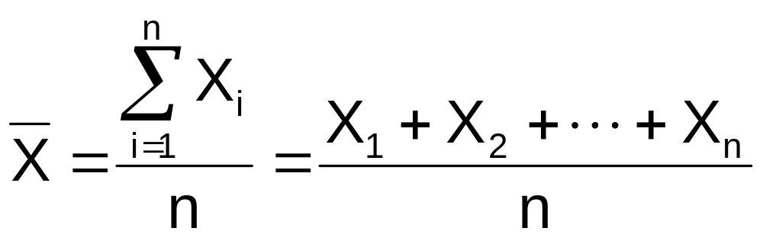
Measures of Central Tendency:
The Mean
The arithmetic mean (often just called the “mean”) is the most common measure of central tendency
  For a sample of size n:
The i^{th} value
Pronounced x-bar
Sample size
Observed values
Chap 3-<number>

Slide 3
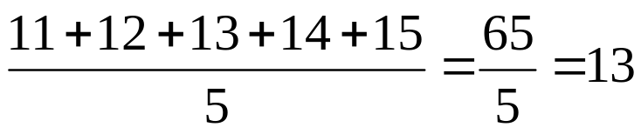
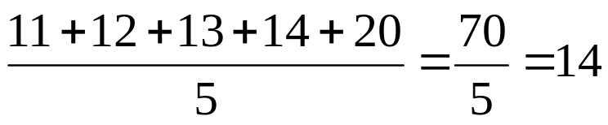
Measures of Central Tendency:
The Mean
(continued)
The most common measure of central tendency
Mean = sum of values divided by the number of values
Affected by extreme values (outliers)
11 12 13 14 15 16 17 18 19 20
11 12 13 14 15 16 17 18 19 20
Mean = 13
Mean = 14
Chap 3-<number>

Slide 4
Measures of Central Tendency:
The Median
In an ordered array, the median is the “middle” number (50% above, 50% below)
Not affected by extreme values
11 12 13 14 15 16 17 18 19 20
11 12 13 14 15 16 17 18 19 20
Median = 13
Median = 13
Chap 3-<number>

Slide 5
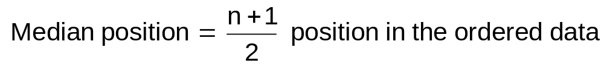
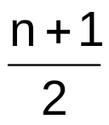
Measures of Central Tendency:
Locating the Median
The location of the median when the values are in numerical order (smallest to largest):
If the number of values is odd, the median is the middle number
If the number of values is even, the median is the average of the two middle numbers
Note that is not the value of the median, only the position of
the median in the ranked data
Chap 3-<number>

Slide 6
Measures of Central Tendency:
The Mode
Value that occurs most often
Not affected by extreme values
Used for either numerical or categorical (nominal) data
There may be no mode
There may be several modes
0 1 2 3 4 5 6 7 8 9 10 11 12 13 14
0 1 2 3 4 5 6
No Mode
Mode = 9
Chap 3-<number>

Slide 7
Measures of Central Tendency:
Review Example
House Prices:
$2,000,000
$ 500,000
$ 300,000
$ 100,000
$ 100,000
Sum $ 3,000,000
Mean: ($3,000,000/5)
= $600,000
Median: middle value of ranked data
= $300,000
Mode: most frequent value
= $100,000
Chap 3-<number>

Slide 8
Measures of Central Tendency:
Which Measure to Choose?
The mean is generally used, unless extreme values (outliers) exist.
The median is often used, since the median is not sensitive to extreme values. For example, median home prices may be reported for a region; it is less sensitive to outliers.
In some situations it makes sense to report both the mean and the median.
Chap 3-<number>

Slide 9
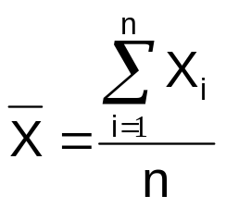
Measures of Central Tendency:
Summary
Central Tendency
Arithmetic Mean
Median
Mode
Middle value in the ordered array
Most frequently observed value
Chap 3-<number>

Slide 10
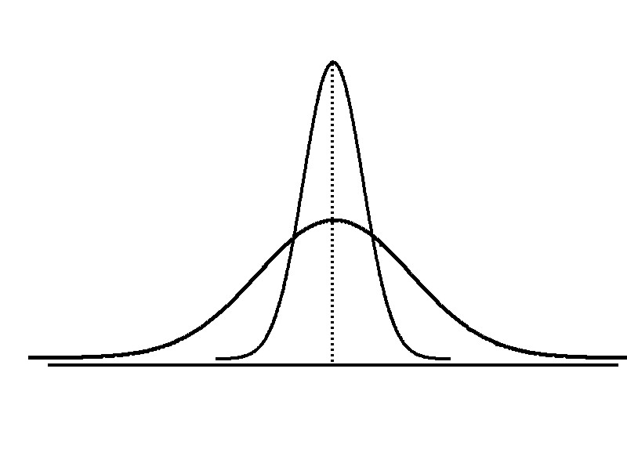
Measures of Variation
Variation
Range
Variance
Standard Deviation
Coefficient of Variation
Measures of variation give information on the spread or variability or dispersion of the data values.
Same center,
different variation
Chap 3-<number>

Slide 11
Measures of Variation:
The Range
Simplest measure of variation
Difference between the largest and the smallest values:
Range = X_{largest} – X_{smallest}
Example:
0 1 2 3 4 5 6 7 8 9 10 11 12 13 14
Range = 13 - 1 = 12
Chap 3-<number>

Slide 12
Measures of Variation:
Why The Range Can Be Misleading
Ignores the way in which data are distributed
Sensitive to outliers
7 8 9 10 11 12
7 8 9 10 11 12
Range = 12 - 7 = 5
Range = 12 - 7 = 5
1,1,1,1,1,1,1,1,1,1,1,2,2,2,2,2,2,2,2,3,3,3,3,4,5
Range = 5 - 1 = 4
1,1,1,1,1,1,1,1,1,1,1,2,2,2,2,2,2,2,2,3,3,3,3,4,120
Range = 120 - 1 = 119
Chap 3-<number>

Slide 13

Measures of Variation:
The Sample Variance
Low variation: more points close to the mean
High variation: more points far from the mean
So, measure the distance to the mean
Chap 1-<number>

Slide 14
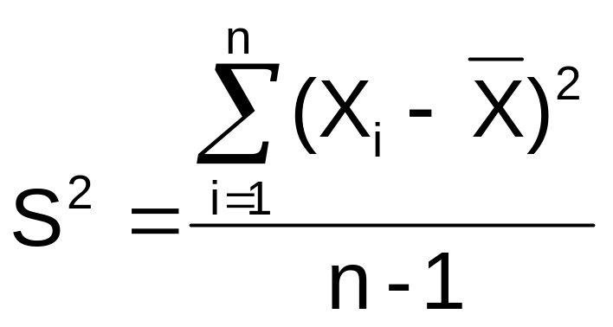

Measures of Variation:
The Sample Variance
Average (approximately) of squared deviations of values from the mean
  Sample variance:
Where
= arithmetic mean
n = sample size
X_{i} = i^{th} value of the variable X
Chap 3-<number>

Slide 15
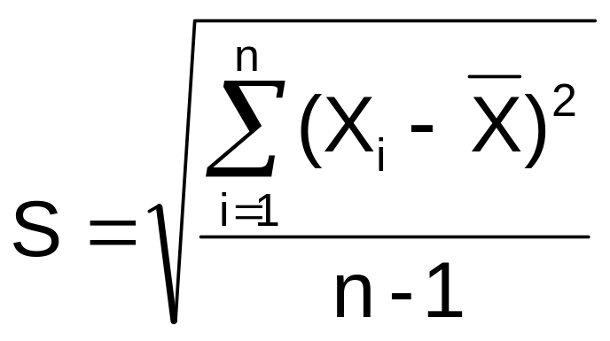
Measures of Variation:
The Sample Standard Deviation
Most commonly used measure of variation
Shows variation about the mean
Is the square root of the variance
Has the same units as the original data
  Sample standard deviation:
Chap 3-<number>

Slide 16
Measures of Variation:
Comparing Standard Deviations
Smaller standard deviation
Larger standard deviation
Chap 3-<number>

Slide 17
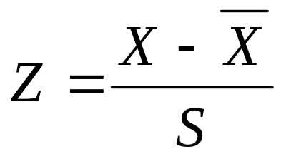
Locating Extreme Outliers:
Z-Score
For a bell-shape (Normal) distribution,
|Z| < 1 for 68% of data
|Z| < 2 for 95% of data
|Z| < 3 for 99.7% of data
So, values X with large |Z| can be outliers.

Slide 18
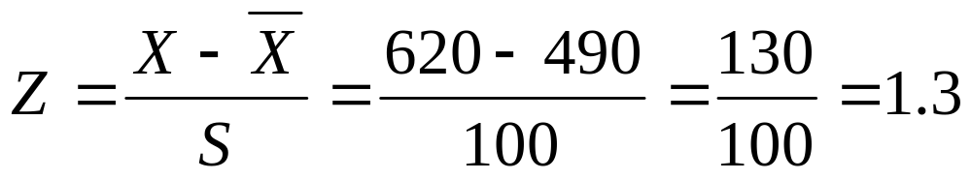
Locating Extreme Outliers:
Z-Score
Suppose the mean math SAT score is 490, with a standard deviation of 100.
Compute the Z-score for a test score of 620.
A score of 620 is 1.3 standard deviations above the mean and would not be considered an outlier.
Chap 3-<number>

Slide 19
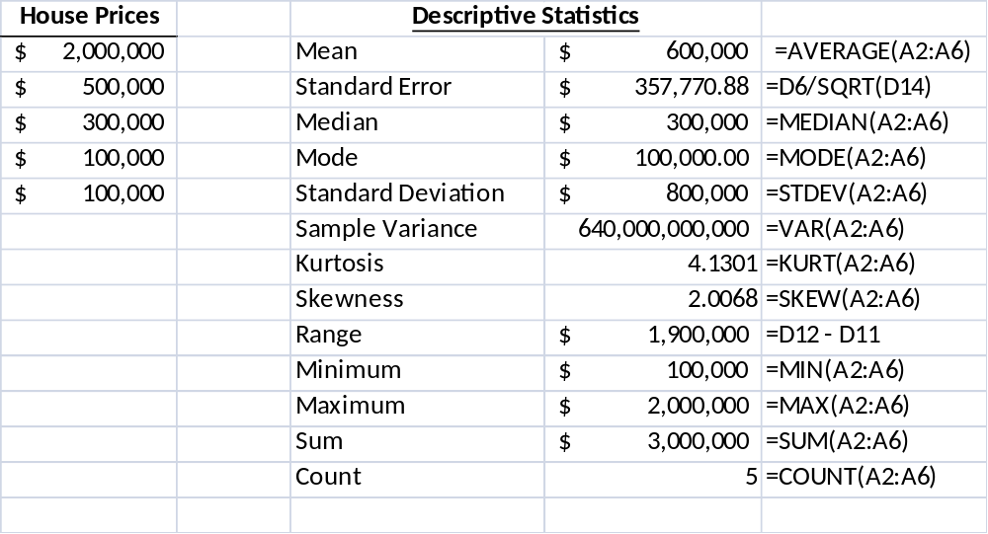
General Descriptive Stats Using Microsoft Excel Functions
Chap 3-<number>

Slide 20
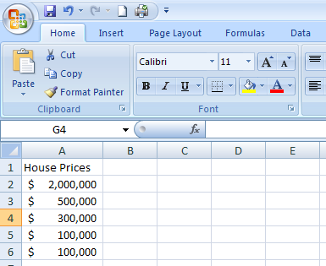
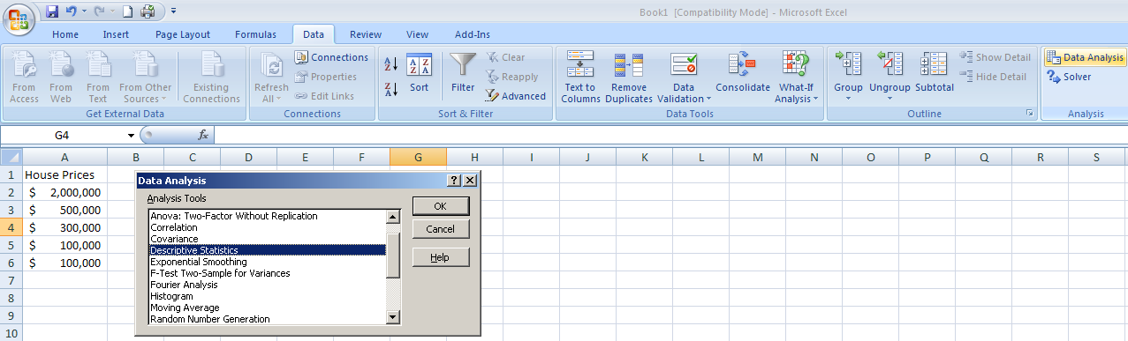
General Descriptive Stats Using Microsoft Excel Data Analysis Tool
Select Data.
Select Data Analysis.
Select Descriptive Statistics and click OK.
Chap 3-<number>

Slide 21
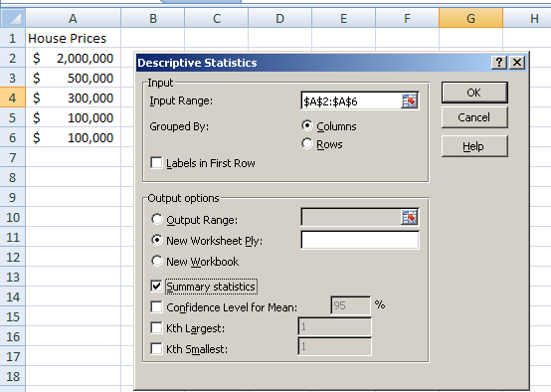
General Descriptive Stats Using Microsoft Excel
4. Enter the cell range.
5. Check the Summary Statistics box.
6. Click OK
Chap 3-<number>

Slide 22
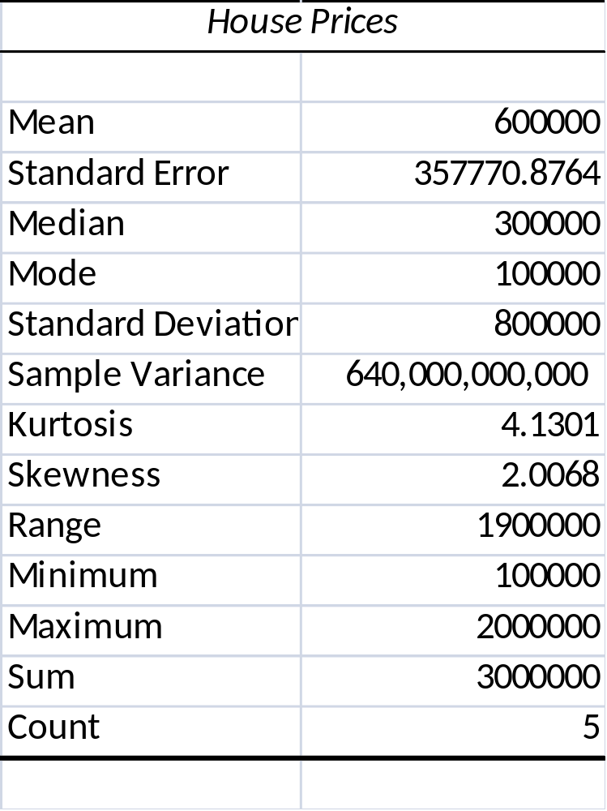
Excel output
Microsoft Excel
descriptive statistics output,
using the house price data:
House Prices:
$2,000,000
500,000
300,000
100,000
100,000
Chap 3-<number>

Slide 23
Numerical Descriptive Measures for a Population
Descriptive statistics discussed previously described a sample, not the population.
Summary measures describing a population, called parameters, are denoted with Greek letters.
Important population parameters are the population mean, variance, and standard deviation.
Chap 3-<number>

Slide 24
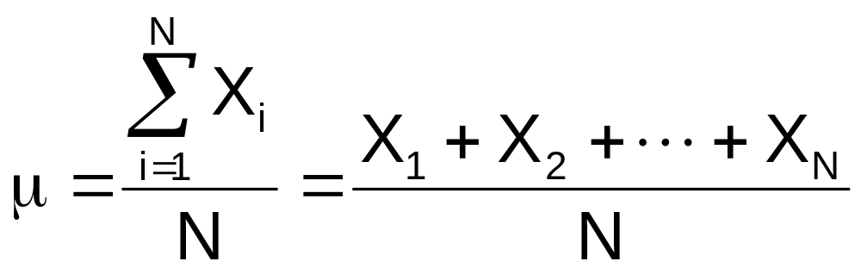
Numerical Descriptive Measures for a Population: The mean µ
The population mean is the sum of the values in the population divided by the population size, N
Where
μ = population mean
N = population size
X_{i} = i^{th} value of the variable X
Chap 3-<number>

Slide 25
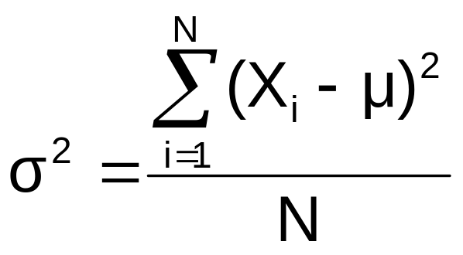
Numerical Descriptive Measures For A Population: The Variance σ²
Average of squared deviations of values from the mean
  Population variance:
Where
μ = population mean
N = population size
X_{i} = i^{th} value of the variable X
Chap 3-<number>

Slide 26
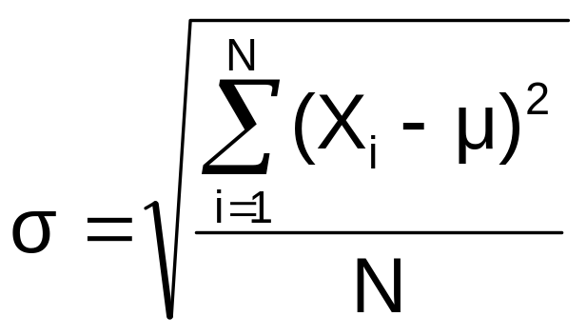
Numerical Descriptive Measures For A Population: The Standard Deviation σ
Most commonly used measure of variation
Shows variation about the mean
Is the square root of the population variance
Has the same units as the original data
  Population standard deviation:
Chap 3-<number>

Slide 27
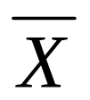





Sample statistics versus population parameters
Measure | Population Parameter | Sample Statistic
Mean
Variance
Standard Deviation
Chap 3-<number>

Slide 28
Quartiles
Quartiles split the ranked data into 4 segments with an equal number of values per segment
25%
25%
25%
25%
Q1
Q2
Q3
The first quartile, Q₁, is the value for which 25% of the observations are smaller and 75% are larger
Q₂ is the same as the median (50% of the observations are smaller and 50% are larger)
Only 25% of the observations are greater than the third quartile
Chap 3-<number>

Slide 29
Quartile Measures:
Locating Quartiles
Find a quartile by determining the value in the appropriate position in the ranked data, where
First quartile position: Q₁ = (n+1)/4 ranked value
Second quartile position: Q₂ = (n+1)/2 ranked value
Third quartile position: Q₃ = 3(n+1)/4 ranked value
where n is the number of observed values
Chap 3-<number>

Slide 30
Quartile Measures:
Calculation Rules
When calculating the ranked position use the following rules
  If the result is a whole number then it is the ranked position to use
  If the result is a fractional half (e.g. 2.5, 7.5, 8.5, etc.) then average the two corresponding data values.
  If the result is not a whole number or a fractional half then round the result to the nearest integer to find the ranked position.
Chap 3-<number>

Slide 31
Quartile Measures
Calculating The Quartiles: Example
Sample Data in Ordered Array: 11 12 13 16 16 17 18 21 22
(n = 9)
Q₁ is in the (9+1)/4 = 2.5 position of the ranked data,
so Q₁ = (12+13)/2 = 12.5
Q₂ is in the (9+1)/2 = 5th position of the ranked data,
so Q₂ = median = 16
Q₃ is in the 3(9+1)/4 = 7.5 position of the ranked data,
so Q₃ = (18+21)/2 = 19.5
Q₁ and Q₃ are measures of non-central location
Q₂ = median, is a measure of central tendency
Chap 3-<number>

Slide 32
Interquartile Range (IQR)
The IQR is Q₃ – Q₁ and measures the spread in the middle 50% of the data
The IQR is also called the midspread because it covers the middle 50% of the data
The IQR is a measure of variability that is not influenced by outliers or extreme values
Measures like Q₁, Q₃, and IQR that are not influenced by outliers are called resistant measures
Chap 3-<number>

Slide 33
Calculating The Interquartile Range
Example:
Median
(Q₂)
X
X
Q₁
Q₃
minimum
maximum
25% 25% 25% 25%
12 30 45 57 70
Interquartile range
= 57 – 30 = 27
Chap 3-<number>

Slide 34
The Five-Number Summary
The five numbers that help describe the center, spread and shape of data are:
  X_{smallest}
  First Quartile (Q₁)
  Median (Q₂)
  Third Quartile (Q₃)
  X_{largest}
Chap 3-<number>

Slide 35
Five Number Summary and
The Boxplot
The Boxplot: A Graphical display of the data based on the five-number summary:
X_{smallest} -- Q₁ -- Median -- Q₃ -- X_{largest}
Example:
25% of data 25% 25% 25% of data
of data of data
X_{smallest} Q₁ Median Q₃ X_{largest}
Chap 3-<number>

Slide 36
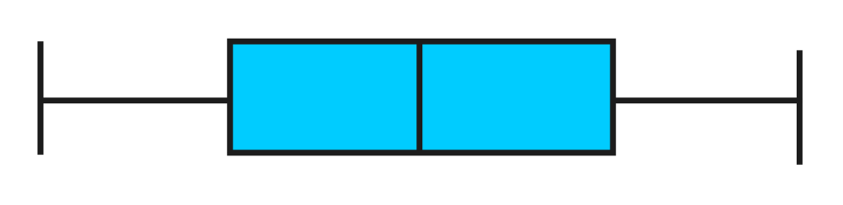
Five Number Summary:
Shape of Boxplots
If data are symmetric around the median then the box and central line are centered between the endpoints
A Boxplot can be shown in either a vertical or horizontal orientation
X_{smallest} Q₁ Median Q₃ X_{largest}
Chap 3-<number>

Slide 37
Distribution Shape and
The Boxplot
Left-Skewed
Symmetric
Right-Skewed
Q₁
Q₂
Q₃
Q₁
Q₂
Q₃
Q₁
Q₂
Q₃
Chap 3-<number>

Slide 38
Measures Of The Relationship Between Two Numerical Variables
Scatter plots allow you to visually examine the relationship between two numerical variables and now we will discuss two quantitative measures of such relationships.
The Covariance
The Coefficient of Correlation
Chap 3-<number>

Slide 39
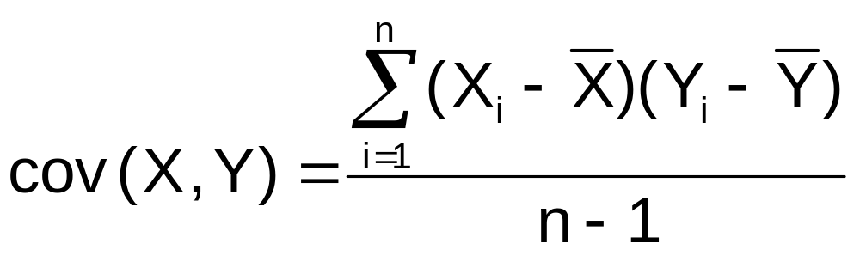
The Covariance
The covariance measures the strength of the linear relationship between two numerical variables (X & Y)
The sample covariance:
Only concerned with the strength of the relationship
No causal effect is implied
Chap 3-<number>

Slide 40
Interpreting Covariance
Covariance between two variables:
cov(X,Y) > 0 X and Y tend to move in the same direction
cov(X,Y) < 0 X and Y tend to move in opposite directions
cov(X,Y) = 0 X and Y are independent
The covariance has a major flaw:
  It is not possible to determine the relative strength of the relationship from the size of the covariance
Chap 3-<number>

Slide 41
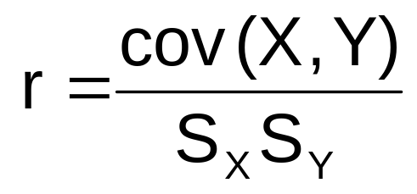
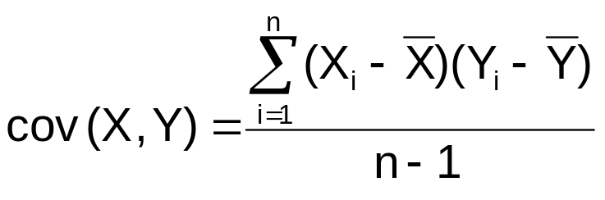
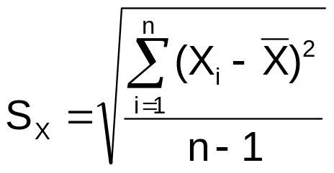

Coefficient of Correlation
Measures the relative strength of the linear relationship between two numerical variables
Sample coefficient of correlation:
where
Chap 3-<number>

Slide 42
Features of the
Coefficient of Correlation
The population coefficient of correlation is referred as ρ.
The sample coefficient of correlation is referred to as r.
Either ρ or r have the following features:
  Unit free
  Ranges between –1 and 1
  The closer to –1, the stronger the negative linear relationship
  The closer to 1, the stronger the positive linear relationship
  The closer to 0, the weaker the linear relationship
Chap 3-<number>

Slide 43
Scatter Plots of Sample Data with Various Coefficients of Correlation
Y
Y
X
X
r = -1
r = -.6
Y
Y
Y
X
X
X
r = +1
r = +.3
r = 0
Chap 3-<number>

Slide 44
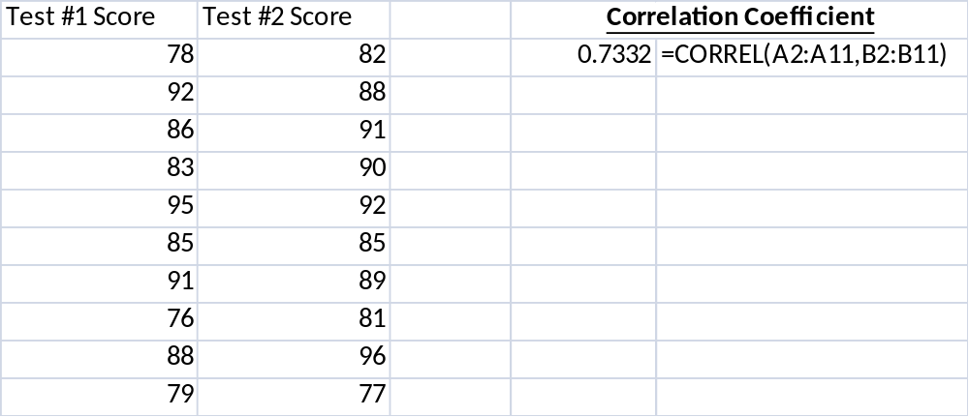
The Coefficient of Correlation Using Microsoft Excel Function
Chap 3-<number>

Slide 45
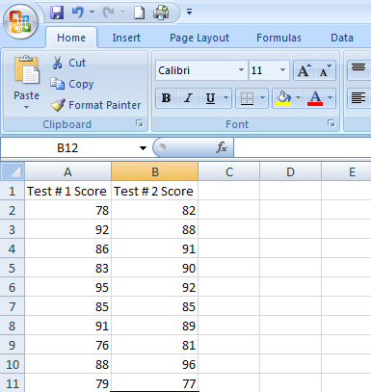
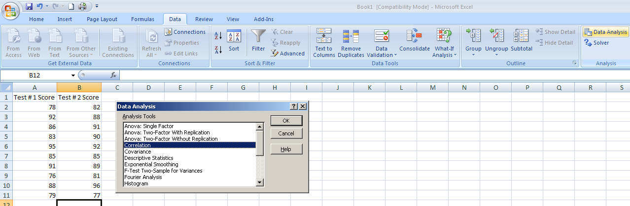
The Coefficient of Correlation Using Microsoft Excel Data Analysis Tool
Select Data
Choose Data Analysis
Choose Correlation & Click OK
Chap 3-<number>

Slide 46
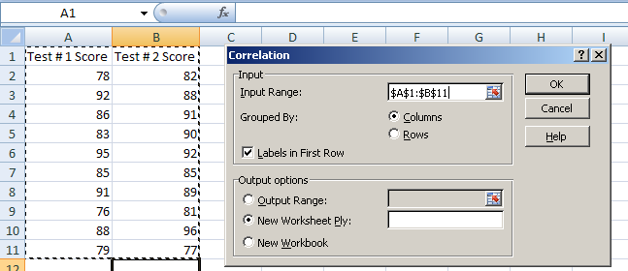
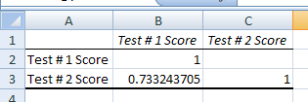
The Coefficient of Correlation
Using Microsoft Excel
Input data range and select appropriate options
Click OK to get output
Chap 3-<number>

Slide 47
Excel
Excel function: =correl
Or use the Data Analysis Tool, “covariance” and “correlation”.
Chap 1-<number>

